Slide 1
Reproduction and Pregnancy History

Slide 2
Reproduction
Added questions on Pregnancy losses 210-211
CAPI system now uses Live Births + Pregnancy Losses to calculate number of entries in pregnancy table
In CAPI added features to add/insert pregnancies, delete pregnancies, re-order pregnancies
To address concerns that DHS was under-estimating fertility and mortality due to difficulty of modifying birth history (as it then was)
Notes:
At DHS we define a CAPI operation as a

Slide 3
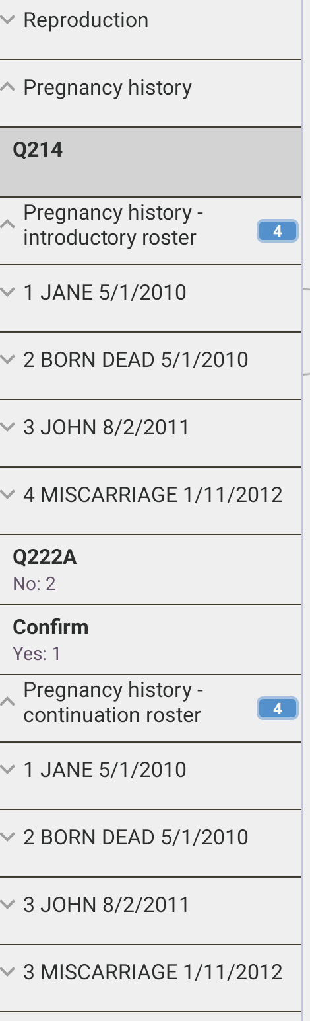
Pregnancy Outcome Table
2 rosters
Part 1 Introductory Roster
Part 2 Continuation Roster
Notes:
At DHS we define a CAPI operation as a

Slide 4
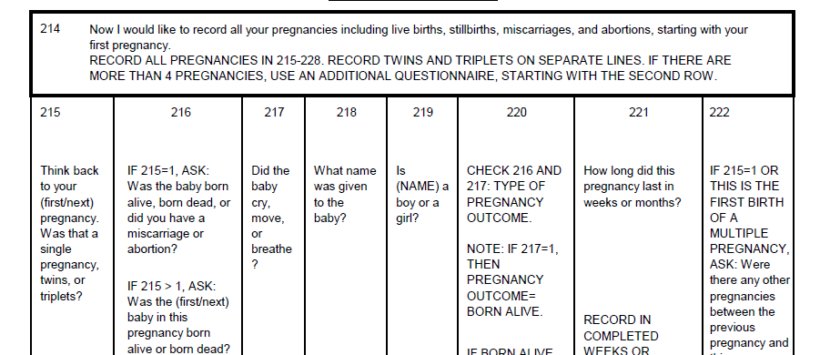
Introductory Roster
Notes:
At DHS we define a CAPI operation as a

Slide 5
Introductory Roster
Single or multiple pregnancy | Q215
Pregnancy outcome | Q216
Baby cried, moved or breathed | Q217
Child name | Q218
Sex of child | Q219
Date of birth/end of pregnancy | Q220
Duration of pregnancy | Q221
Pregnancy between this and prior pregnancy | Q222
Notes:
At DHS we define a CAPI operation as a

Slide 6
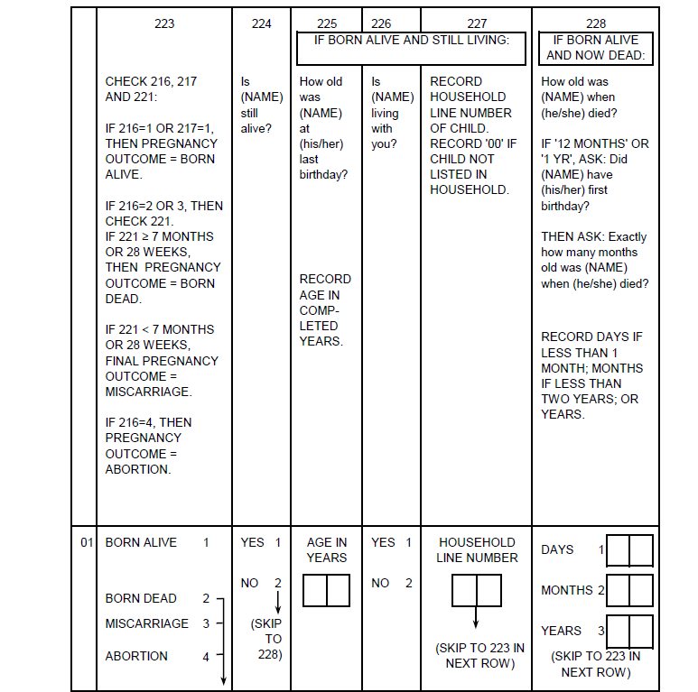
Continuation Roster
Notes:
At DHS we define a CAPI operation as a

Slide 7
Continuation Roster
Pregnancy outcome (final) | Q223
Child is still alive | Q224
Current age of child | Q225
Child living with respondent | Q226
Line number in the household | Q227
Age at death | Q228
Notes:
At DHS we define a CAPI operation as a

Slide 8

Points to remember : Pregnancy losses
Pregnancy losses : stillbirths, miscarriages and abortions treated differently from live births by the CAPI system when completing the pregnancy history.
Name field for the pregnancy will be automatically filled by the CAPI system with the type of outcome. For example, for a stillbirth, the text “BORN DEAD” will appear in the name field for that pregnancy.
The question text for Q220 will change to “On what day, month and year did this pregnancy end” instead of “... was [Name] born”.
Questions Q224 – Q228 (alive, age, residence) will be skipped

Slide 9
Points to remember : Multiple births
Multiple births can have different outcomes eg one miscarriage one live birth
Multiple births must be within 1 day of each other otherwise an error message will be generated

Slide 10
Points to remember : Controlling number of entries in pregnancy table
Q212 Total Pregnancy Outcomes controls initial number of entries in pregnancy table
Once the interviewer enters the first question in the table
Number entries in the table can only be reduced by using the delete function from CAPI toolbar
Can be increased by changing totals in Q201-Q211 or by using “add/insert” function
Reducing totals in Q201-Q211 won’t change the number of entries in the pregnancy table

Slide 11
Demonstration
Grace
She had three pregnancies since January 2010; the first,
resulted in twins but only one was born alive (Jane), while the other was a stillbirth. Jane was born in the eighth months of pregnancy on January 5 2010. Her younger brother, John, was born in February 2014 in the ninth month of pregnancy (eight completed months). When asked if there was a pregnancy between Jane and John, the respondent stated that she had a miscarriage in November 2012. She was 2 months pregnant.
Entering section 2

Slide 12
Challenge when using Android CAPI
Need to ensure pregnancies entered in correct order, sometimes may need to add/delete or re-order pregnancies
Can be difficult to see context of where user is in the table
Solution:
make use of navigation bar to keep track of where you are in the pregnancy table
use the “Pregnancy History” report on the CAPI toolbar

Slide 13
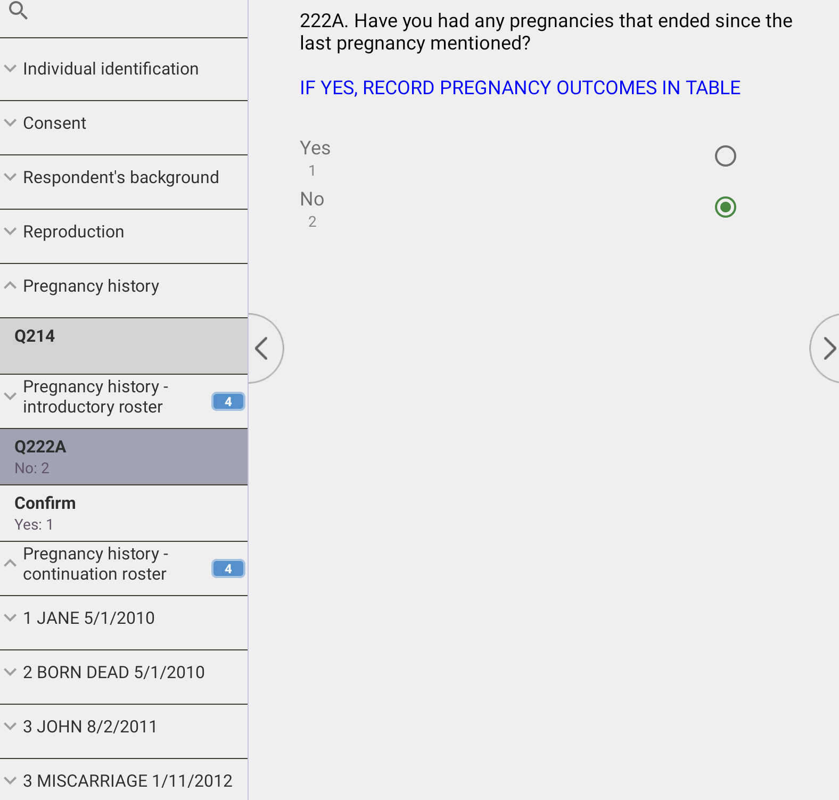
Navigation bar

Slide 14
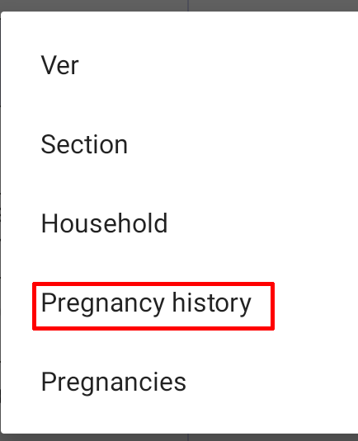

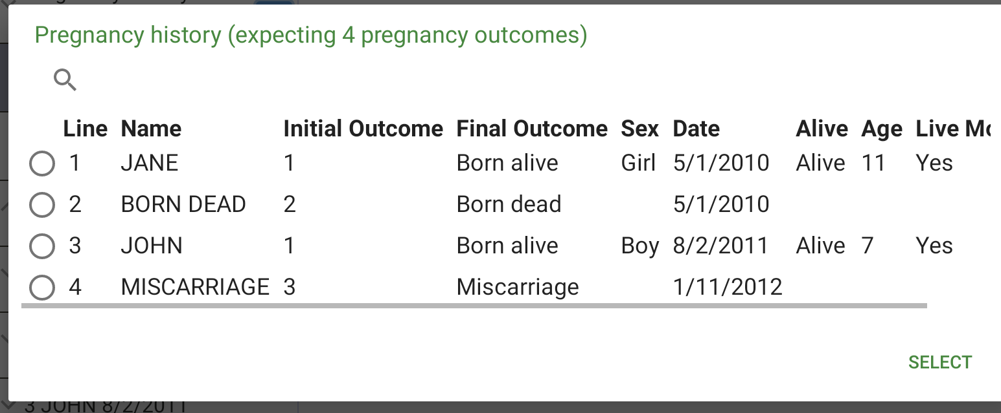
CAPI Tool bar pregnancy history

Slide 15
Modifying structure of entries in pregnancy outcome table
Action | How | Why ?
Add or insert | “yes” response to probe questions Q222 OR using the “Add” or “Insert” functions from the CAPI Toolbar | Respondent may omit pregnancy outcomes in their initial reporting
Delete | “Delete” function in the CAPI toolbar | Interviewer error, entries that are not biological children of respondent, other ?
Re-order | “Move” function in the CAPI toolbar | If pregnancy outcomes are listed out of order of date of end of pregnancy. The system will check and show a message if entries are out of order

Slide 16
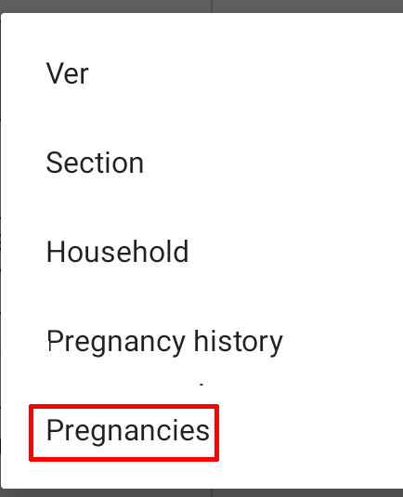
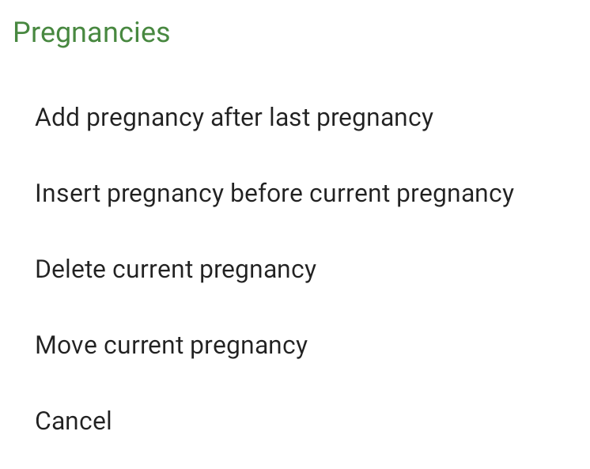
CAPI Tool bar pregnancies

Slide 17
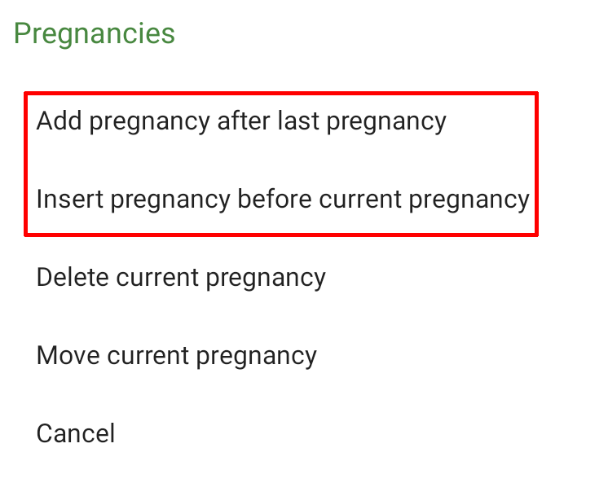
Inserting or adding pregnancies: steps
1.Move to the pregnancy before which you wish to insert pregnancy
2.Use toolbar option Insert or Add after last pregnancy
3 Once the entry is inserted the system will move to the first question
4.Complete the questions
5.Update reproduction section totals
6.Use “Advance to End” to move through to next entry
Note : if pregnancy inserted as a result of “yes” response to Q225, follow steps 3-6

Slide 18
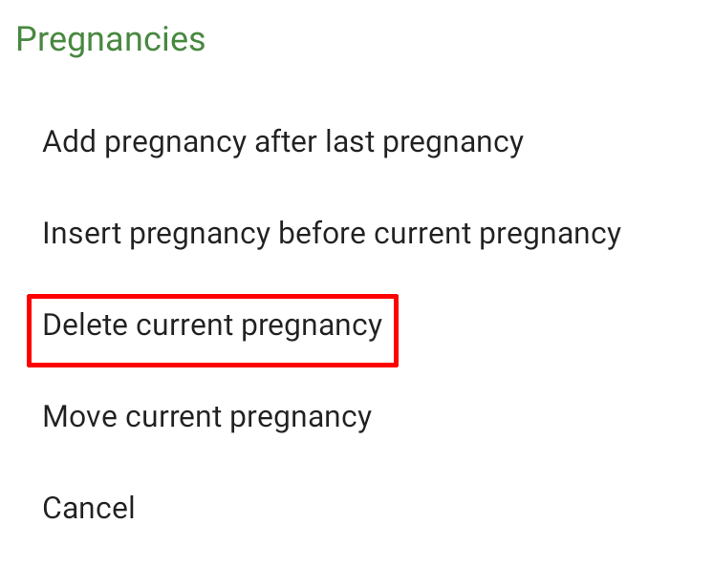
Deleting pregnancies: steps
1.Move to any question for the pregnancy which you wish to delete
2.Use toolbar option Delete
3 Once the entry is deleted the system will move to the first question of the following pregnancy
4.Update reproduction section totals
6.Use “Advance to End” to move through to next entry

Slide 19
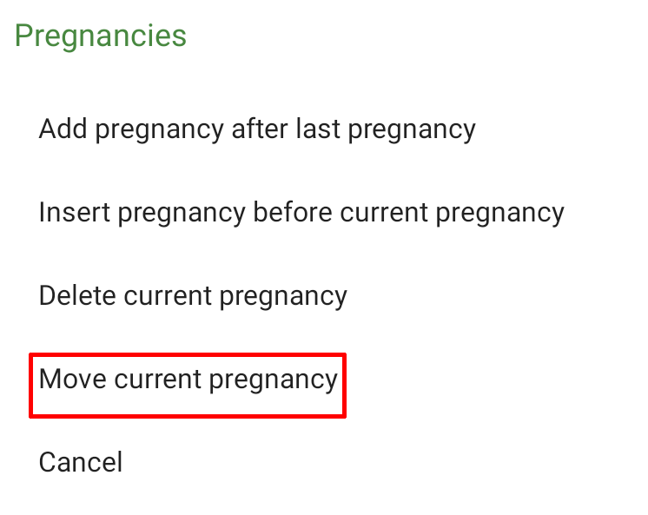
Moving pregnancies: steps
1.Move to any question for the pregnancy you wish to move
2.Use toolbar option Move
3 Pick the pregnancy you wish to move the current entry before
4.Use “Advance to End” to move through to next entry
Note: you can only move pregnancies UP the table not DOWN, so pick the more recent pregnancy to move

Slide 20
Consistency checks between reproduction and pregnancy table
Total live births in Q208 must equal total of live births in pregnancy table
Total pregnancy losses in Q212 must equal number of miscarriages/abortions/stillbirths in pregnancy table

Slide 21
THANK YOU
Questions or Comments?

